Slide 1
Meeting 25/03/2022

Slide 2
Models
50x2 inputs of P & R -> 1x1 output: P
50x2 inputs of P & R -> 1x1 output: R
50x2 inputs of P & R -> 1x2 outputs: P & R
10x2 inputs of P & R -> 1x2 outputs: P & R
30x2 inputs of P & R -> 10x2 outputs: P & R

Slide 3
LSTM models to predict PR separately
Input/output:
50x2 input -> 1x1 output
2 Stacked LSTM’s
128 hidden layers
8 epochs
64 batch size

Slide 4
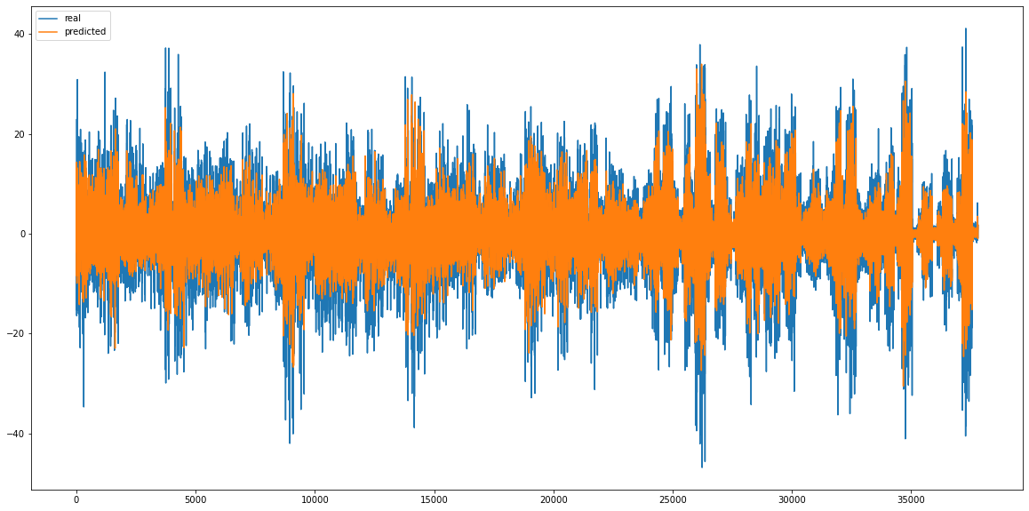
Pitch predictor

Slide 5
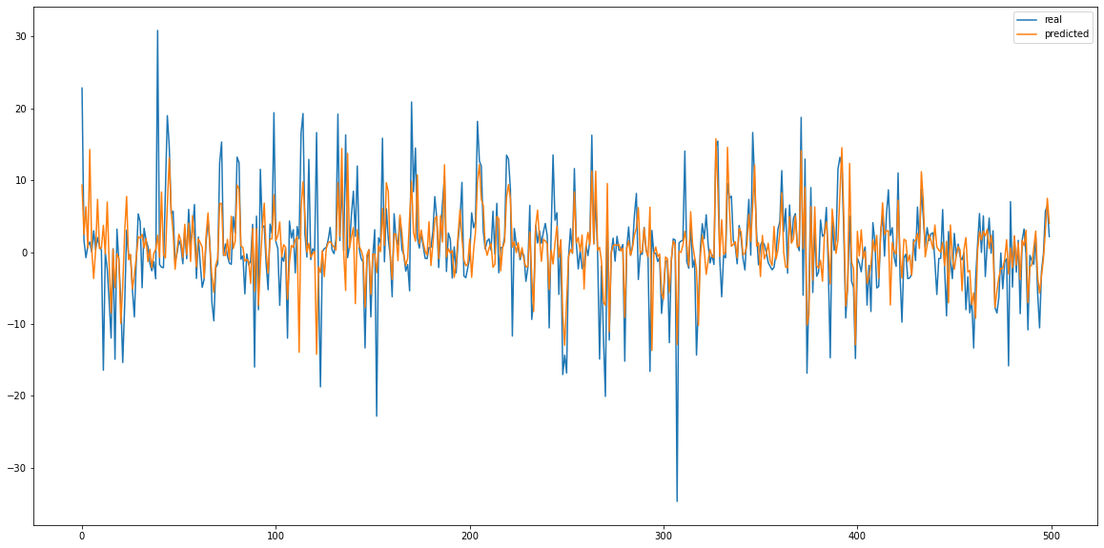
Pitch predictor

Slide 6
Pitch predictor
Real prediction
MSE: 0.00271
RMSE: 0.0521
RMSE denorm: 4.69°
Zero prediction
MSE 0: 0.00511
RMSE 0: 0.0715
RMSE 0 denorm: 6.43°
Improvement on zero prediction:
MSE delta%: 188.47 %
RMSE delta%: 137.28 %

Slide 7
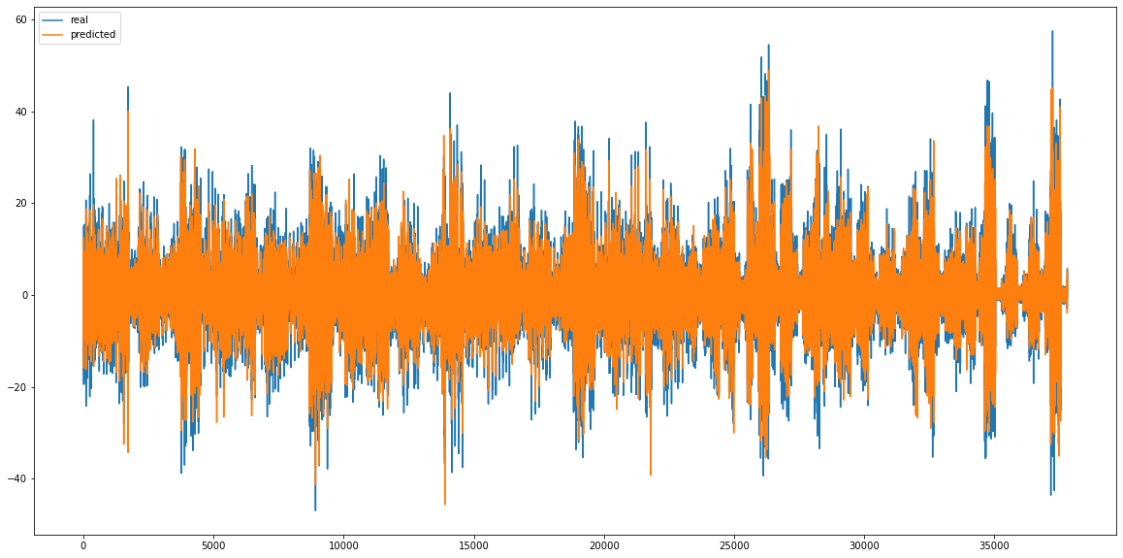
Roll predictor

Slide 8
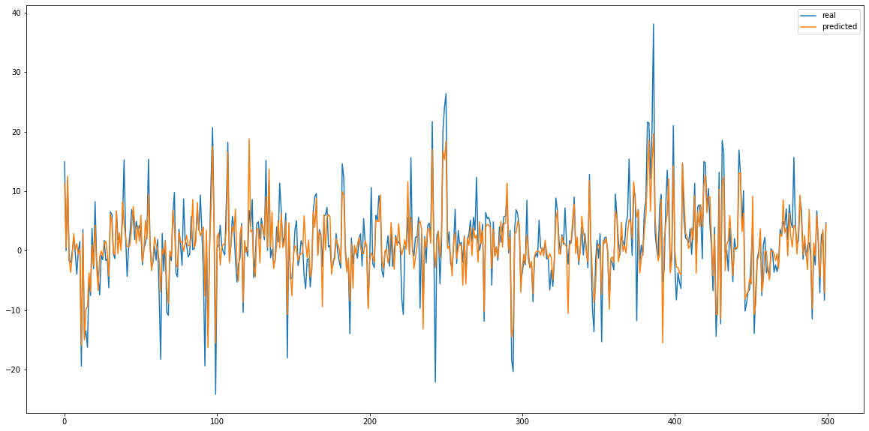
Roll predictor

Slide 9
Roll predictor
Real prediction
MSE: 0.00174
RMSE: 0.0418
RMSE denorm: 3.76°
Zero prediction
MSE 0: 0.00657
RMSE 0: 0.0811
RMSE 0 denorm: 7.29°
Improvement on zero prediction:
MSE delta%: 376.27 %
RMSE delta%: 193.98 %

Slide 10
LSTM models to predict PR simultaneous
Input/output:
50x2 input -> 1x2 output
10x2 input -> 1x2 output
2 Stacked LSTM’s
128 hidden layers
50 and 100 epochs
64 batch size

Slide 11
PR 50

Slide 12
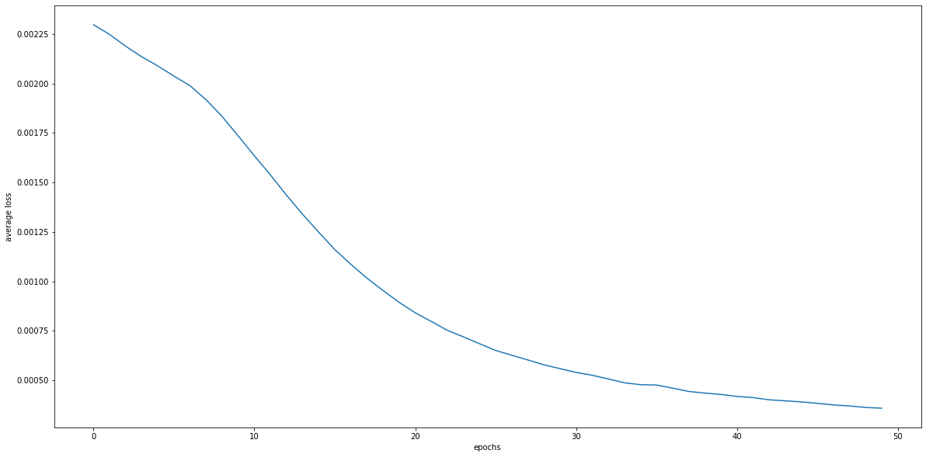
PR predictor – training loss

Slide 13
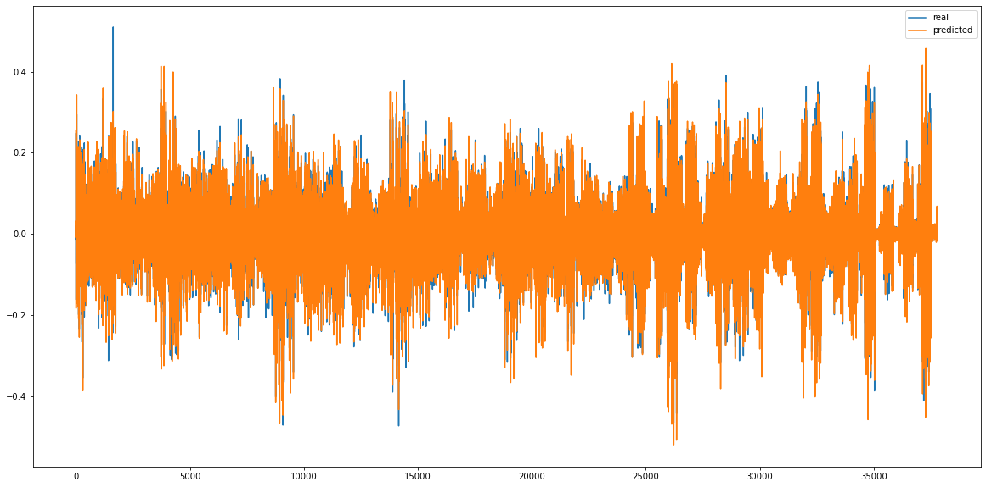
PR predictor - Pitch

Slide 14
PR predictor - Pitch
Real prediction
MSE: 0.000584
RMSE: 0.0241
RMSE denorm: 2.17°
Zero prediction
MSE 0: 0.00511
RMSE 0: 0.0715
RMSE 0 denorm: 6.43°
Improvement on zero prediction:
MSE delta%: 874.53 %
RMSE delta%: 295.72 %

Slide 15
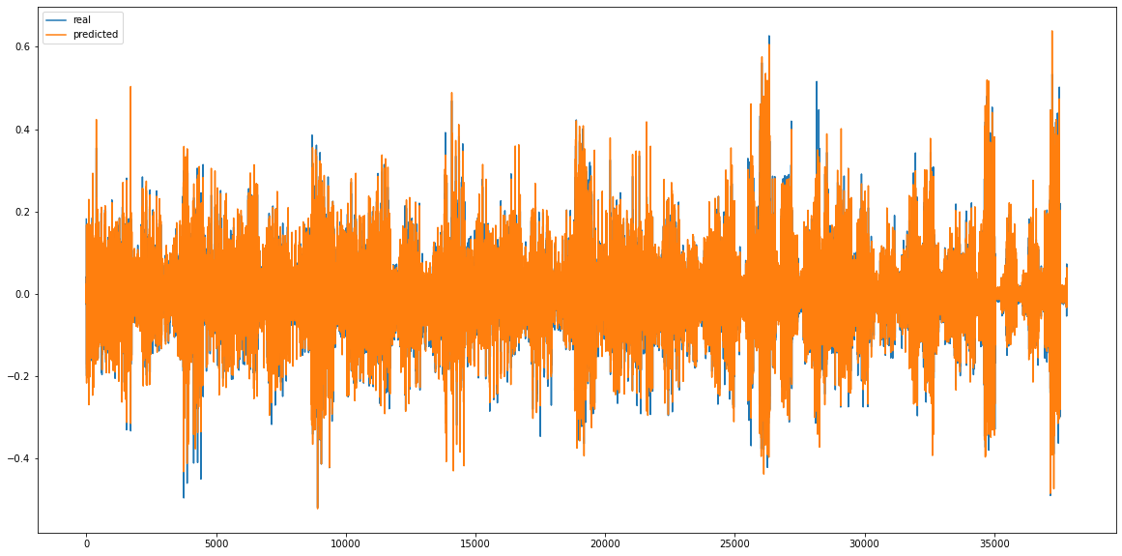
PR predictor – Roll

Slide 16
PR predictor – Roll
Real prediction
MSE: 0.000513
RMSE: 0.0226
RMSE denorm: 2.03°
Zero prediction
MSE 0: 0.00657
RMSE 0: 0.0811
RMSE 0 denorm: 7.29°
Improvement on zero prediction:
MSE delta%: 1281.26 %
RMSE delta%: 357.95 %

Slide 17
PR 10

Slide 18
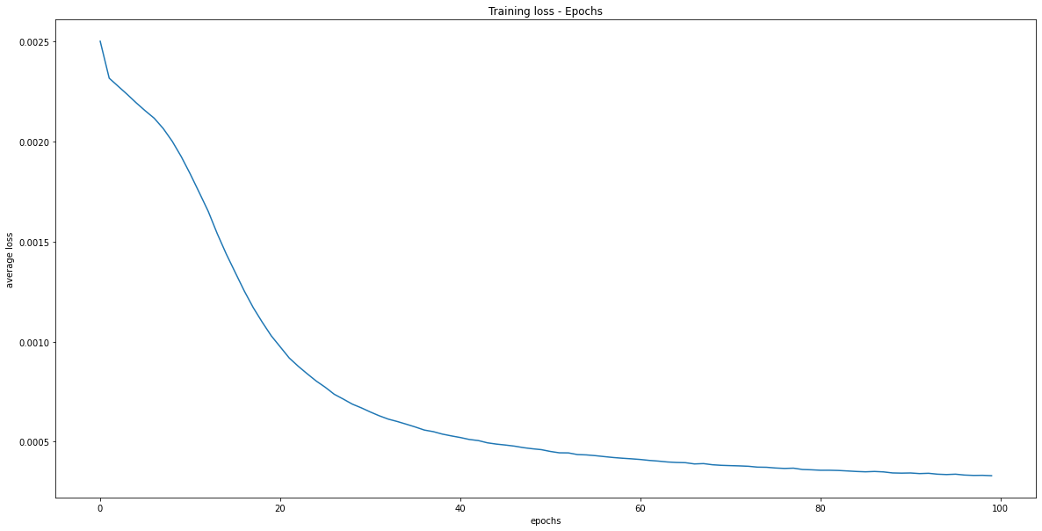
PR predictor – training loss

Slide 19
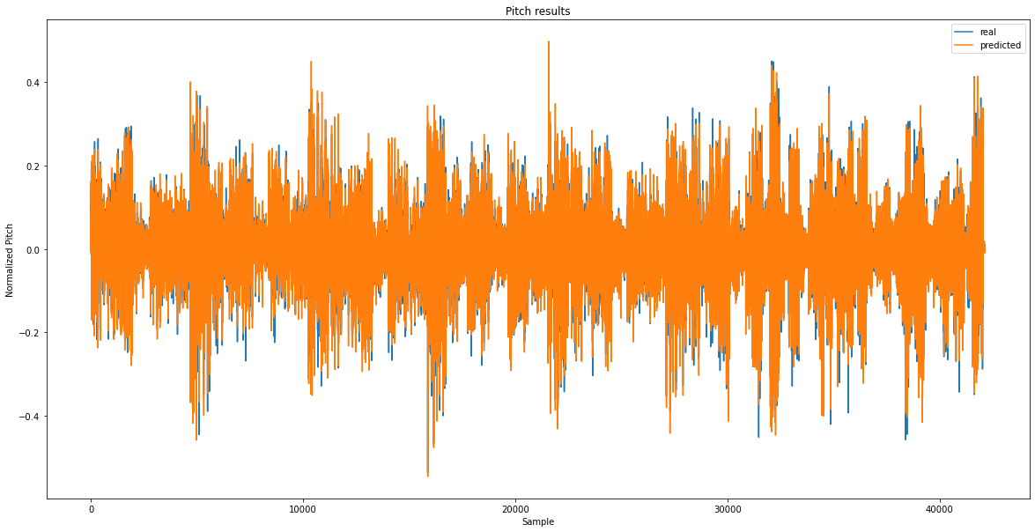
PR predictor - Pitch

Slide 20
PR predictor - Pitch
Real prediction
RMSE denorm: 2.34°
Zero prediction
RMSE 0 denorm: 6.55°
Improvement on zero prediction:
RMSE delta%: 279.74 %

Slide 21
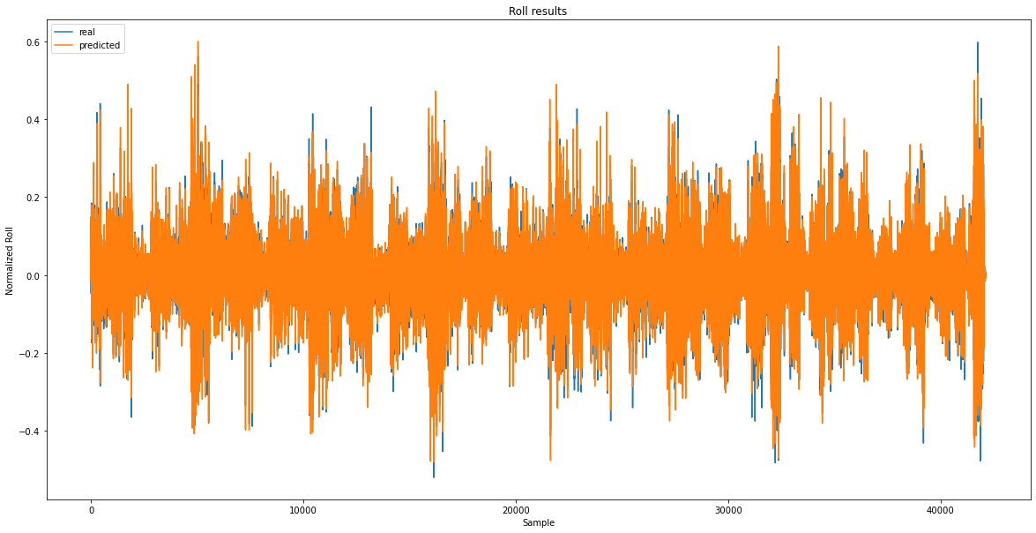
PR predictor – Roll

Slide 22
PR predictor – Roll
Real prediction
RMSE denorm: 2.09°
Zero prediction
RMSE 0 denorm: 7.08°
Improvement on zero prediction:
RMSE delta%: 338.67 %

Slide 23
Results
MODEL (in -> out - epoch) | PITCH (denormalized RMSE) | ROLL (denormalized RMSE)
50x2 PR -> 1x1 Pitch - 8 | 4.69° | /
50x2 PR -> 1x1 Roll - 8 | / | 3.76°
50x2 PR -> 1x2 PR - 8 | 4.40° | 3.54°
50x2 PR -> 1x2 PR - 50 | 2.17° | 2.03°
10x2 PR -> 1x2 PR - 50 | 2.34° | 2.09°

Slide 24
Plato thesis title
“Ship motion prediction using deep learning and sensor fusion”

